Slide 1
Studio Sustainability Standard
Terms of Reference

Slide 2
Contents
Introduction
Assessment components
Assessment process
Governance
Updates to the Standard
Complaints procedure

Slide 3
1. Introduction
1.Introduction
The Studio Sustainability Standard is a voluntary global standard for studio facilities. It was developed by albert with the help of Arup, as technical partner and an industry steering group of major studios and producers.
This document sets out the Terms of Reference for the Studio Sustainability Standard (Standard), including the assessment components, assessment process, governance, process for updates to the Standard and addressing complaints.

Slide 4
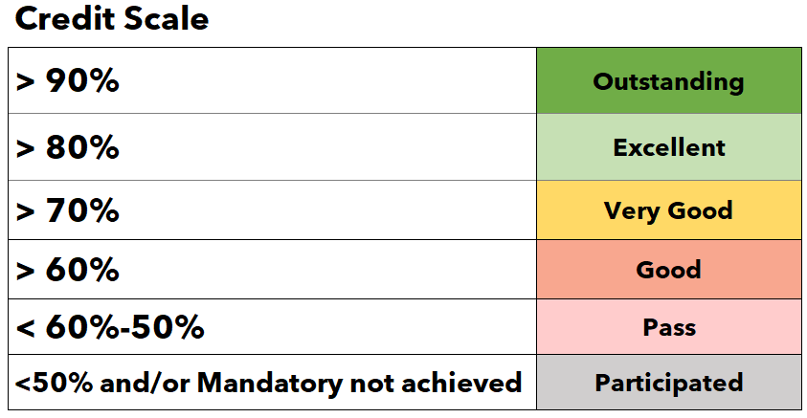
2. Assessment components
Overall Sustainability Score
Each Studio is assessed using six different categories:
Climate
Circularity
Nature
People
Management
Data
The Standard has two key components:
1. Key Performance Indicators (KPIs) by Sustainability Theme
KPIs are designed to require either a Y/N answer or select a preset % level of attainment.
KPIs are either Mandatory (the answer to these questions must be ‘yes’ in order to achieve certification), or Optional (these are not mandatory but count towards getting a better certification score).
2. Data Reporting by Sustainability Theme
The data collection is either Mandatory or Optional, and will be used to inform future target setting and potential industry-wide reporting.
Scoring
Each studio facility assessed will receive a Sustainability Score. Credits are available to be achieved based on meeting the KPIs and Data Reporting requirements. The summation of these credits provides the overall sustainability score.
There are different bands, based on the score achieved. The thresholds for these bands can be found in the table to the right.
50%
Pass
Sustainability score bands

Slide 5
2. Assessment components
Mandatory requirements:
There are a number of data inputs that must be provided in order to meet mandatory minimum requirements.
In addition, in order to achieve an Excellent or above rating, there are a number of KPIs that must be achieved.
Note: Where studios have been in operation less than 18 months and do not have a verified 12 month dataset within the reporting period, they will still meet the mandatory requirements, provided they submit the data they have available relevant to the reporting period. This data will not be used as part of the benchmarking or anonymised reporting process.
Weighting:
Weightings have been applied to each Sustainability Theme, based on outcomes of the materiality assessment and stakeholder engagement.
A summary of mandatory requirements and weightings is shown on this page.
 |  | Mandatory (Pass) |  | Mandatory (Excellent) |  | Sustainability Score
 |  | Available | % Achieved | Available | % Achieved | Available | % Achieved | Section Weighting | Weighted section score | Score
Climate |  | N/A |  | 10 | X% | 31 | X% | 35% | X% | X%
Circularity |  | N/A |  | 3 | X% | 21 | X% | 20% | X%
Nature |  | N/A |  | 1 | X% | 9 | X% | 15% | X%
People |  | N/A |  | N/A |  | 9 | X% | 10% | X%
Management |  | N/A |  | 2 | X% | 7 | X% | 10% | X%
Data |  | 9 | X% | N/A |  | 22 | X% | 10% | X%

Slide 6
3. Assessment process
Submission Form
The Scorecard is an excel file, downloadable from the albert website. It is to be submitted via email to studiostandard@bafta.org.
Submission Period
May to July each year.
Final deadline for submissions will be set for end of July each year.
Length of certification
The label and score are valid for one year.
Fees
There is an annual fee to tak part. Fees are based on square footage of sound stages. Please contact studiostandard@bafta.org for a quote.
Data confidentiality
Please refer to albert’s privacy policy:
https://wearealbert.org/privacy-policy/
Registration
Completed by Studio for each studio facility
Submission
Assessment completed and submitted by Studio for each studio facility
Review
albert review of narrative and scoring to confirm assessment score
Audit
Spot-check audits of 20% of submissions to confirm evidence base
Results Reporting
Anonymised reporting per studio facility and industry wide

Slide 7
Completion of Scorecard
Studios will complete the Scorecard themselves, it is a self-assessment process. There is no minimum competency required for a person to undertake the self-assessment, however it is recommended a Sustainability Professional be involved if possible.
A narrative response including description of evidence available is required for each KPI, guidance on expected evidence is included within the Scorecard.
Evidence collation
Evidence is not requested as part of the submission process.
Studios are requested to maintain evidence on file to support their submission response. These will need to be made available in the event the studio is identified for a spot-check audit.
Review of submissions
Each submission will be reviewed by albert to check completeness and robustness of the narrative provided. The quality of the narrative provided will be judged against the description of required evidence included within the Scorecard.
Spot-check audits
Audits will be undertaken annually of up to 20% of the studios that submitted that year. Audits will involve:
A request for all evidence referenced within the submission response
A desktop review of the evidence by albert team
Communication to clarify findings
Report outlining findings from audit.
Reporting
An anonymised benchmarking report will be provided to all participating Studios. This will enable comparison of performance against other participating studios.
An industry-wide report will be released to comment on observations and trends from the reporting year, and provide recommendations for improvement areas across the industry.
Results will be released in October of each year, along with case studies highlighting good performance.

Slide 8
4. Governance
Steering Group
A Steering Group has been formed, engaging a balanced and representative group of stakeholders. This includes albert, international and regional industry body representation, major and minor studio representation, geography representation and Technical Partner Arup. Membership of the Steering Group will be reviewed annually by albert.
The objective of the Steering Group will be to:
Ensure governance processes are implemented appropriately, including internal audit of the assessment process.
Review performance results annually
Contribute to review and update of the Standard.
Outcomes of Steering Group meetings will be documented.

Slide 9
5. Updates to the Standard
Updates to the Standard
Feedback on use of the Standard is welcomed, and feedback on use of the standard can be made at any time via studiostandard@bafta.org
The Standard will be reviewed at regular intervals.
Notice will be given of proposed updates on the albert website.
Public consultation will be held to enable input into future updates, the window for public consultation will be made available on the albert website. The input received and the outputs of its consideration will be documented.
All records related to the development of the Standard, including the documented process and stakeholders engaged will be kept on file for a minimum of five years.

