Slide 1
Studio Facility Sustainability Standard
Scope of Standard

Slide 2
Contents
Introduction
Scope of Standard
Sustainability Outcomes
Standard Setting Process
Establishing the Need
Stakeholder Engagement
Materiality Assessment

Slide 3
1. Introduction
1.Introduction
albert has recognised the need for a globally supported standard to drive improvements in studio facility sustainability.
This document sets out the scope of the Studio Facility Sustainability Standard (Standard), the material sustainability topics it addresses, and the evidence base and process for its development and continual improvement.

Slide 4
1.1 Objectives and Drivers
The following key objectives and drivers have been identified for the Standard:
Provide clear signposting to all studio stakeholders (productions, participating studios, and others) about the things that really matter
Provide the common rulebook that progressive studios are looking for
Accelerate the adoption of best practice
Meet and exceed the demands and expectations of the investor community
Drive sustainability performance and push industry competition within and between studios and productions
Attract like-minded investors through clearly communicated green credentials and compliance
Studios begin to offer services that enable productions to meet their own sustainability aspirations
Align with legislation and policy, and current reporting processes to meet global commitments such as Net Zero ambitions.
The following key criteria for success have been identified for the Standard:
Provides guidance for sustainability improvement
Encourages participation
Studios start to offer sustainable services that support productions
Productions are incentivised and start to use sustainable services offered by studios
Facilitate processes which enable productions to report on sustainability data
Rewards good performance
Provides external recognition
Is sufficiently independent / robust
Facilitates direct competition / comparison
Takes into account different studio types and geographic locations
Is flexible, and enables different entry levels of performance
Overcomes challenges in benchmarking performance data
Encourages an holistic approach to environmental and social issues
Is focussed on largest impacts and greatest opportunity to control / influence.

Slide 5
2. Scope of Standard
Type of studio:
Geographic region
The Standard has been developed to apply to the UK, US and Canadian contexts. However the nature of the questions asks means they are broadly applicable globally. Future reviews of the Standard will include applicability to other geographies.
Types of studio and production
The Standard applies to the following:
Studio and production combined: The studio has full control over the productions. They can influence decision making and drive sustainability. They can also combine the productions.
Studio operates site and provides rental space: The studio have limited influence over the productions currently. Each production on site works within their own boundaries and there is little cross collaboration.
Site repurposed by production for filming: The production in this case are managing the site. This allows for full control and influence over retrofit process and then production operations once in use.
Filming spaces and non-filming spaces
Television and film studio spaces
Studios of any age.
Studio activity
The Standard applies to studios in operation. It may be used as guidance to inform the design and construction of new studios/refurbishments.

Slide 6
Studio activities
The Standard addresses impacts associated with the following studio activities.
Topic | Activity
Energy, Gas and Water | Electricity and heating (gas) provision to whole site
 | Electricity and gas provision to production stages
 | Lighting in stages
 | Electricity production from on-site renewable generation
 | Water supply for whole site
 | Water for stages
 | EV charging stations
 | Generator use and fuel
Waste | Waste from whole site (inc offices, workshops, outdoor spaces)
 | Waste water and effluents
 | Food donations from studio
 | Food waste from studio canteen
 | Food donations from productions
 | Waste from production stages
 | Props, costumes, furniture and production items donations
Materials and food | Production materials for set (walls, lumber, construction materials)
 | Props, costumes, furniture and filming equipment
 | Production catering
 | Construction materials for site (ongoing maintenance)
 | Studio catering – food and materials, equipment
 | Office, kitchen and workshop materials
Topic | Activity
People | Comms and signage around the site – waste and behaviour
 | Community outreach
 | Training/Skills/Employment
Space provision | Stages and broadcast suites
 | Canteen / Dining area
 | Production offices and workshops
 | Dressing rooms, costume storage, hair and make up
 | Set storage and warehousing
 | Dye and Paint rooms
 | Car park car charging space
 | Toilet (equipment + cleaning)
 | Backlot and outdoor spaces
Transport | Public transport access
 | Studio vehicles (transport around site)
 | Travel to work schemes / Car share
 | Studio deliveries
 | Transportation of production materials/costumes/set materials to and from site
 | Consolidate logistics of general production materials

Slide 7
3. Sustainability Outcomes
The table below outlines the key sustainability themes, outcomes and topics addressed by the Standard. These are based on the findings from the Scoping and Materiality Assessment, described in Sections 5 to 7.
Theme | Outcome | Sustainability Topics
Climate | Drive the industry transition towards net zero carbon and be resilient to climate change. | Energy Demand Energy Generation Fuel Use Water Use Transport Resilience
Circularity | Support the transition to a circular economy through minimising waste and material use. | Waste Generation Waste Management Materials Use – Responsible Sourcing Materials Use – Sharing and Re-Use Schemes Supply Chain Management
Nature | Protect and enhance green space and nature, improving resilience and providing connections for people and broader ecosystem networks. | Responsible Food Sourcing Biodiversity
People | Support wellbeing of visitors, workers, local communities and supply chains. | Wellbeing of Workers Community Outreach and Charitable Donations Employment, Skills, and Training Supply Chain Management Diversity and Accessibility

Slide 8
4. Standard setting process
The Standard was developed in 2021, with initial launch in 2022. The diagram below sets out the standard setting process, including stakeholder engagement and consultation.
2021
2022
2023
2024
Scoping and Stakeholder engagement
Launch of Studio Facility Standard 1.0
Year 1 implementation
Year 2 implementation
Update of Standard
Launch of Studio Facility Standard 2.0
Industry
Piloting
Reporting of Results
Reporting of Results
Consultation
Approval of Standard
Establishment of Steering Group
Steering Group Strategic Review
Steering Group Strategic Review
Approval of Update

Slide 9
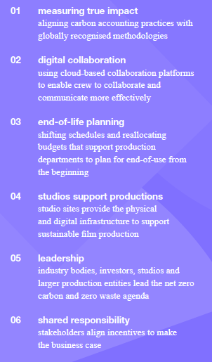
5. Establishing the need
The need for change Arup worked with BFI’s Research and Statistics Fund and the BAFTA-led consortium albert to develop a vision for future sustainable film production.
Published in 2020, A Screen New Deal (see References) was the first study of its kind for the film industry, providing proposals, recommendations and case studies of global best practice.
The Report examined the systemic changes needed within film production to reduce carbon emissions and opportunities to reach net zero.
Arup conducted an industry wide stakeholder engagement exercise, across the whole film production landscape. Combined with expert knowledge of carbon reduction strategies and circular business models, Arup developed strategic ways in which the film production ecosystem could work towards more sustainable practices.
The Image (Right) outlines the key findings and lessons learned from the research piece. 04 Studio Support Productions highlights the key role of studio sites to provide the infrastructure and services to support sustainable film productions – a key consideration in the development of a studio sustainability evaluation system.

Slide 10
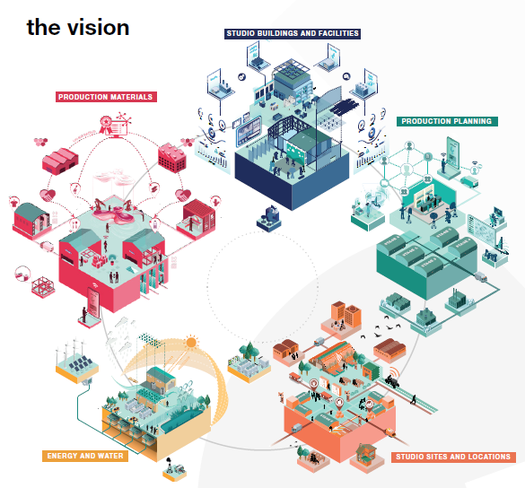
Opportunity areas
'Screen New Deal' identified actions under each opportunity area. These informed development of topics and KPIs for the Standard.
Energy and Water
Studio Sites and Locations
Reducing energy demand
Passive design
Green infrastructure
Low energy lighting
Consolidated movement
Demand prediction
Shared transport
Production business hub
Sustainable energy sources
Renewable energy
Battery storage
Microgrids
Wayfinding and communication
Physical wayfinding
Real-time information display
Digital concierge
Production Planning
Water demand reduction
Rainwater harvesting
Greywater recycling
Composting toilets
Health and wellbeing
Centralised catering facilities
Work-life facilities
Crew and staff changing rooms
Reuse of materials
Sharing platforms
Warehouses
Material passports
Production Materials
Buying virgin materials responsibly
Responsible sourcing
Sustainable materials
Local sourcing
Collaboration tools
Collaboration platforms
Cloud computing
Sharing Data
Studio Buildings and Facilities
Repurposing buildings
Building retrofit
Flexible spaces
Adaptable buildings
Virtual planning
Virtual reality
5G
3D capture
Buying products as a services
Products as a service
Predictive maintenance
Modular construction
Shared infrastructure
Online location libraries
Shared procurement services
Industry sustainability fund
Smart building management
Building information modelling
Sensors/Dashboards

Slide 11
Review of relevant industry standards and guidance
By reviewing industry standards and guidance, an indicative picture of synergies and challenges throughout the film industry began to emerge. The Table below outlines sustainability topics and key performance indicators common across the Film Industry. The topics presented below are ordered based on their prevalence within the literature review, and have been assessed for their applicability / relevance to Film Studios. As indicated by the key, those marked in green note key performance indicators within the industry standard / guidance related to the sustainability criteria; and those marked in orange note reference to a vision / objective. Within the literature review, very few presented clear targets for the film sector. However, a common indicator is noted for maximising recycled paper; minimising single-use plastics; and wider industry calls for net-zero carbon and net-zero waste.
Environmental Scope |  | albert Carbon Calculator Tool (2021) | BFI (Green Matters) March 2020 | BFI Sustainability and Film Production (2019) | Carbon Footprint of Movie and Film Production Location Choice: The Real Cost (2016) | Controlling Environmental Cost in the Production Industry | Green Screen - Helping London's Film and TV Industry to Tackle Climate Change (2009) | Green Film Rating | Green Shoots: Environmental Sustainability and Contemporary Film Production (2015) | Netflix Sustainability Commitments | Producers Guild of America - Green Production Guide Toolkit | Screen New Deal Report | Sky’s Sustainable Production Principles | Sony Studio Sustainability | SPA - Carbon Emissions of Film and Television Production | Sustainable Development Goals for the Film Industry | Production Environmental Actions Checklist (PEACH) | Production Environment Accounting Report (PEAR) | Production Lumber Material (PLUM) | Misc. Articles
OBJECTIVES, TARGETS AND KEY PERFORMANCE INDICATORS | Energy
 | Materials & Waste
 | Carbon
 | Transport
 | Supply Chain
 | Water
 | Biodiversity
Key
 | Environmental Key Performance Indicator
 | Environmental Objective / Vision
 | Not Referenced
Most Prevalent Sustainability Criteria
Energy (67%)
Materials & Waste (67%)
Carbon (57%)
Transport (43%)
Supply Chain (33%)
Water (22%)
Biodiversity (11%)

Slide 12
Relevant existing rating schemes and standards
The table below presents a sample of sustainability assessment tools and implementation models that were reviewed to inform scoping the Studio Sustainability Standard. The assessment tools and implementation models have been categorised according to their governance model typology.
Rating Scheme Model | Examples | Rating Scheme Model | Examples
Rating Schemes | BREEAM CEEQUAL DGNB Envision Green Star GRESB LEED Living Building Challenge | Guidance / Principles | Buying Green Handbook ISPE Sustainability Handbook Wild West End Value Matrix
 |  | Awards | Considerate Constructors Scheme National Awards IEMA Sustainability Awards
Certification Standard | ISO 14001: 2015 Environmental Mgt System (ISO 14001) Sustainable Event Mgt System (ISO 20121) | League Tables | DJSI Happy Planet Index People and Planet University League
Label and Scoring System | B-Corp Considerate Constructors Scheme Green SEAL Award | Self-appraisal and reporting | SPeAR Green Production Guide Toolkit

Slide 13
6. Stakeholder engagement
The Standard has been developed in collaboration with the industry. Studios and relevant institutions have been involved through a series of engagement activities, including interviews, workshops and review processes.
Stakeholders have contributed to key milestones within the Standard’s development, including the materiality assessment, the format of the Standard, piloting of the draft standard to refine the key performance criteria and the governance arrangements for how the Standard is to be implemented.
The stakeholders who have contributed to the development of the Standard are listed here.
UK Institutions
UK Studios
US Studios
British Film Institute
Elstree
CBS (Viacom/Paramount)
British Film Commission
Sky
Disney
Wolf
Fox
Pinewood
Netflix
Sony

Slide 14
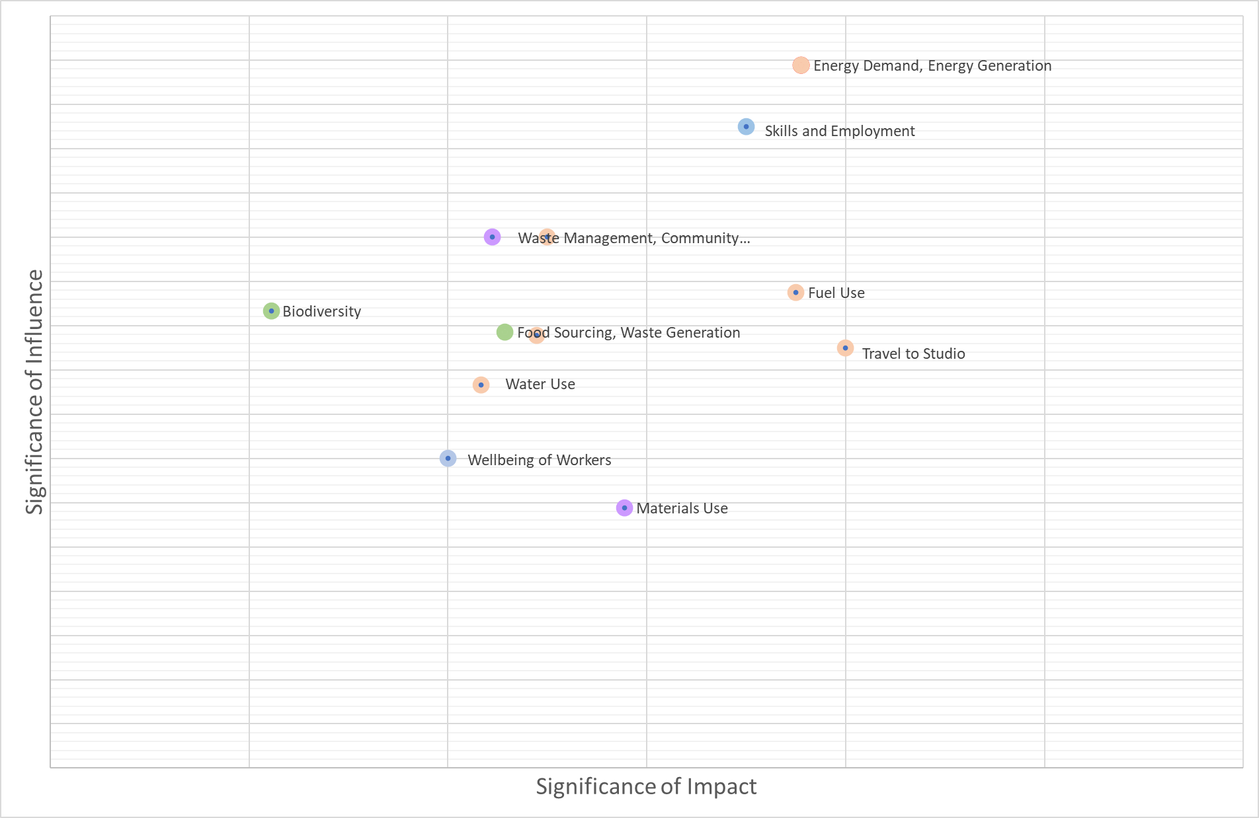
7. Materiality Assessment
To inform the development of the Standard, a materiality assessment was conducted, based on outcomes of interviews and the literature review.
The exercise involved an indicative mapping of a typical studio’s significance of impact and scope of influence by key sustainability topic.
The diagram presents the outcomes of the materiality assessment. This has informed development of the Standard. This exercise will be reviewed at regular intervals.

Slide 15
References
albert (2021), Methodology Paper – albert Carbon Calculator, Available at: https://wearealbert.org/production-handbook/toolkit-methodology/
albert, British Film Institute, Arup (2019), A New Screen Deal: A Route Map to Sustainable Film Production, Available online: https://www.bfi.org.uk/strategy-policy/policy-statements/sustainability
albert (2021), Creative Offsets, Available online: https://wearealbert.org/creative-offsets/
British Film Institute (2020), Green Matters: Environmental Sustainability and Film Production: An Overview of Current Practice, Available online: https://www2.bfi.org.uk/sites/bfi.org.uk/files/downloads/bfi-green-matters-uk-screen-sector-report-2020-v1.pdf
Buchanan, Carolyn (2016), Carbon Footprint of Movie Production, Available online: http://nrs.harvard.edu/urn-3:HUL.InstRepos:33797344
Digital Production Office (2016), Controlling Environmental Costs in the Production Industry, Available online: https://www.digitalproductionoffice.com/wp-content/uploads/2016/12/controlling-environmental-cost-in-the-production-industry_01.1_interactive.pdf
Film London, Mayor of London (2009), Green Screen: Helping London’s Film and TV Industry to Tackle Climate Change, Available online: https://www.london.gov.uk/sites/default/files/green_screen.pdf
Green Film (2021), Green Film Rating System, Available online: https://www.green.film/
Green Production Guide (2021), Green Production Guide Toolkit, Available online: https://www.greenproductionguide.com/tools/
Green Screen Interreg Europe, European Regional Development Fund, VAF (2017), Sustainable Development Goals: Guide for the Filming Sector, Available online: https://www.interregeurope.eu/fileadmin/user_upload/tx_tevprojects/library/file_1576852213.pdf
Netflix (2021), Net Zero + Nature: Our Commitment to the Environment, Available online: https://about.netflix.com/en/news/net-zero-nature-our-climate-commitment
Sky (2021), Sky’s Sustainable Production Principles, Available online: https://static.skyassets.com/contentstack/assets/bltdc2476c7b6b194dd/blt2311f761467bc5c5/5ffd6e97da1b7963accaf684/Sky_Sustainable_Production_Principles_-_FINAL_12.01.21.pdf
Sustainable Production Alliance (2021), Carbon Emissions of Film and Television Production, Available online: https://www.greenproductionguide.com/wp-content/uploads/2021/04/SPA-Carbon-Emissions-Report.pdf
Victory, J. (2015), Green Shoots: Environmental Sustainability and Contemporary Film Production, Available online: https://www.researchgate.net/publication/279216497_Green_Shoots_Environmental_Sustainability_and_Contemporary_Film_Production

